Slide 1
Connection Between Arable Land And GDP In Vietnam
QUOC DUNG NGUYEN

Slide 2
Dataset(s)
World Development Indicators Dataset

Slide 3
Motivation
From the data, I want to know the relationship between Arable land per person compared to GDP of Vietnam over the year.

Slide 4
Research Question(s)
How does GDP affects the arable land per person?

Slide 5
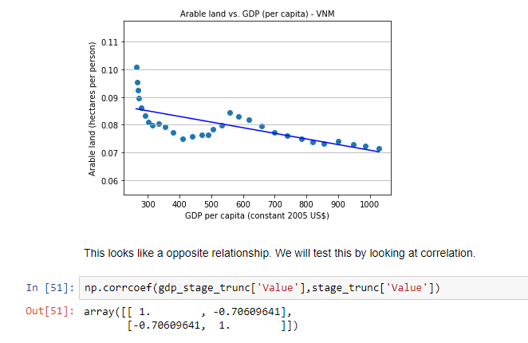
Findings
With the increase of GDP over the year, the arable land (hectares per person) reduced with a negative correlation of -0.70.

Slide 6
Acknowledgements
Did you use other informal analysis to inform your work? Did you get feedback on your work by friends or colleagues? Etc.
If you had no one give you feedback, it’s okay to say that.
I have no feedback on my work yet.

Slide 7
References
Data Source: https://www.kaggle.com/worldbank/world-development-indicators

